Slide 1
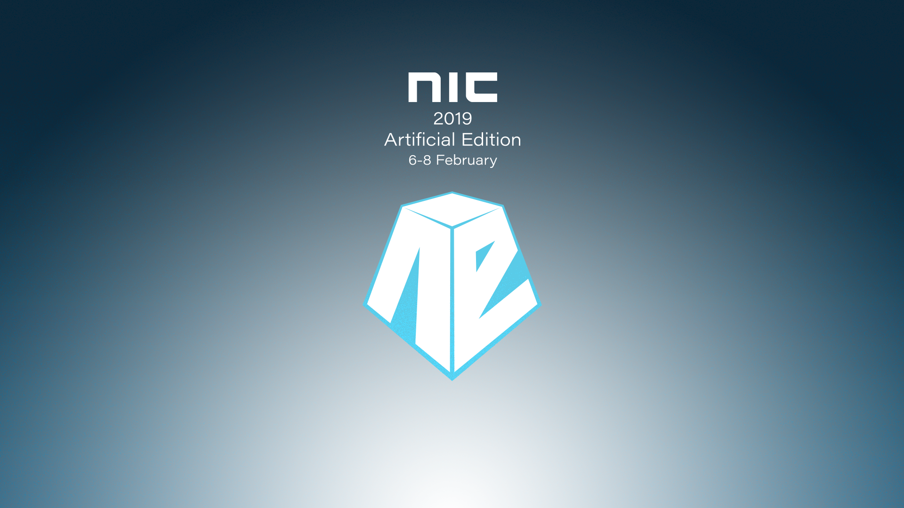

Slide 2

Android Management

Slide 3


Kent Agerlund

Slide 4
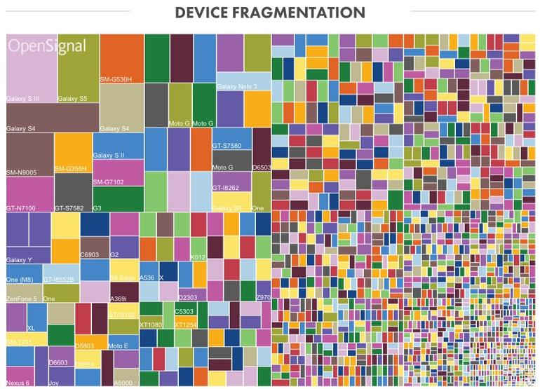
Only the Brave
Source: http://opensignal.com/reports/2015/08/android-fragmentation/

Slide 5




Agenda
Android’s enterprise evolution
Device Admin
Enterprise Admin
Scenarios

Slide 6
Android Management history

Slide 7

A brief history of Android device and app management
Android basic MDM
OEM Extensions
Formerly Android for Work (AfW)
APIs introduced in Android 2.2.x
Basic MDM capabilities,
Enhanced platform capabilities
Samsung introduces KNOX/SAFE additional capabilities over Android
Other OEMs follow suit to various degrees
No standardization amongst many private APIs
Managed app distribution with Google Play
Android enterprise
Intune App Protection policies (APP)
Available for managed and unmanaged devices
Two new management modes and different scenarios
Available in many Microsoft apps, 3rd party apps
Work profile (BYOD)
Device owner (corp owned)
One management mode: DeviceAdmin

Slide 8
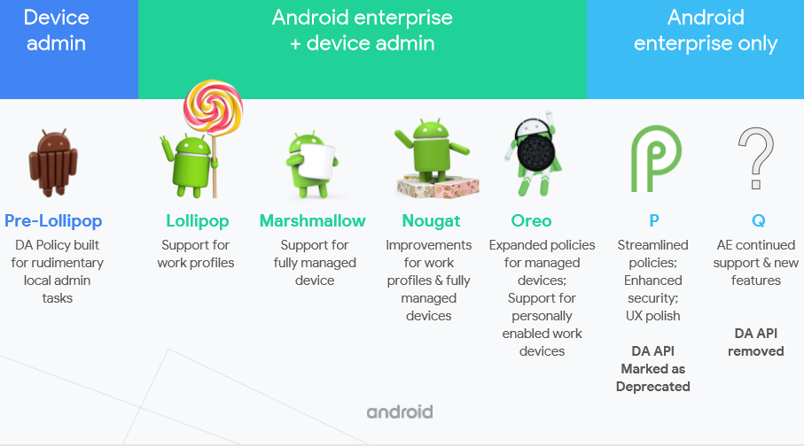
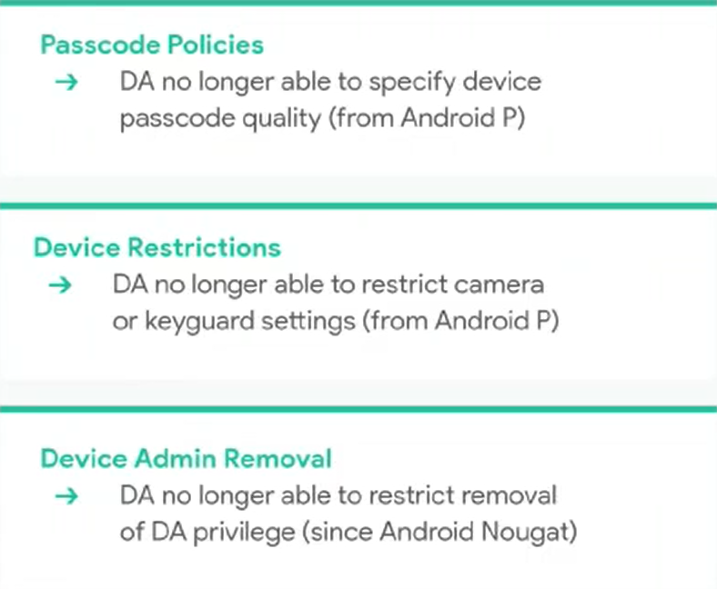
Android Enterprise continues to evolve
DA will be unavailable on devices with Android Q
DA will continue to work for pre-Q devices
Intune will continue to support DA
Source: Android partner summit, May 2018

Slide 9
Device Admin

Slide 10
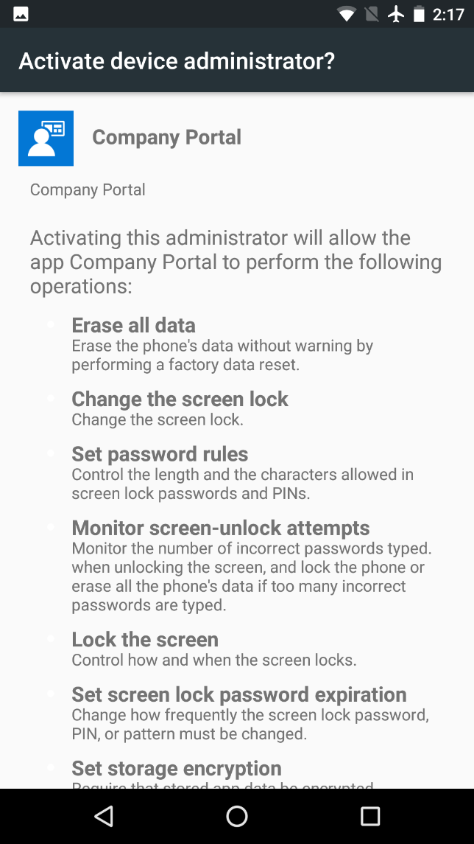
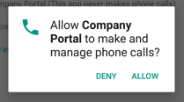
Why Device Admin “Legacy” device management is bad
Deprecation announced
Announced publicly by Google Dec 19
Deprecated in Android 9/P
Removal in Android 10/Q
Pervasive, but lacking
Outdated security model
Rudimentary
Malware abuse
Highly fragmented implementation across OEMs

Slide 11
Transitioning away from Device Admin management
Migrate to managed Google Play
Publish LOB apps
Approve public apps
Phasing out Device Admin
Cap and grow for BYOD
Adapting to work profile
Resolve policy overlap
Restrict to single identity
Transition for corp-owned

Slide 12
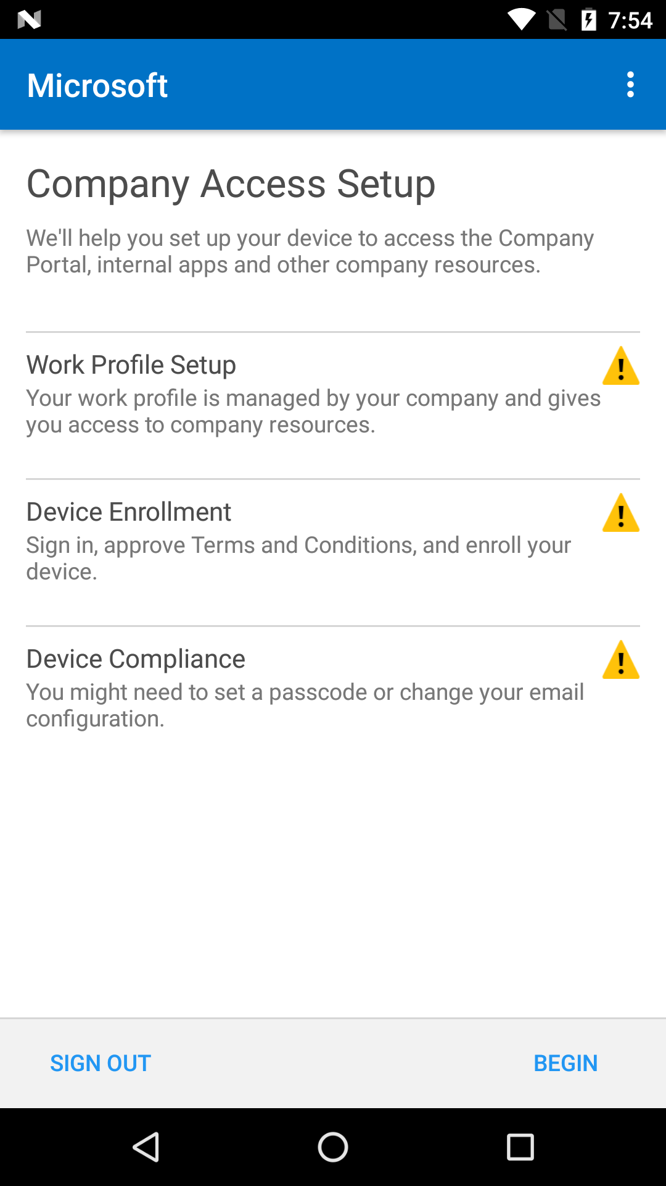
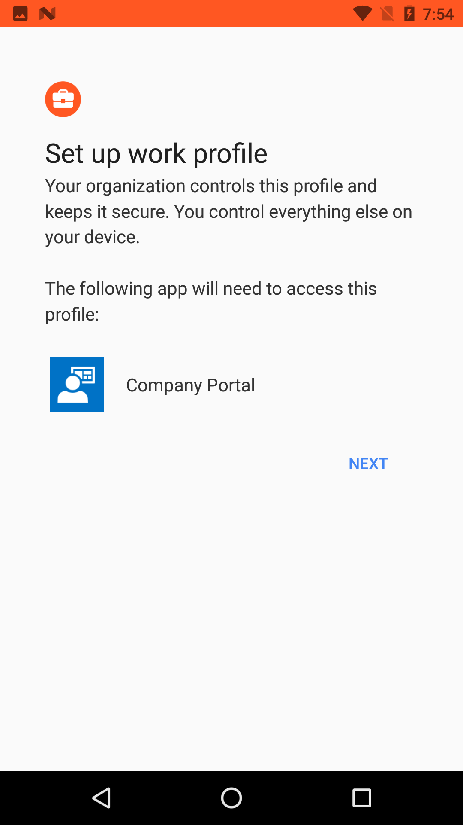
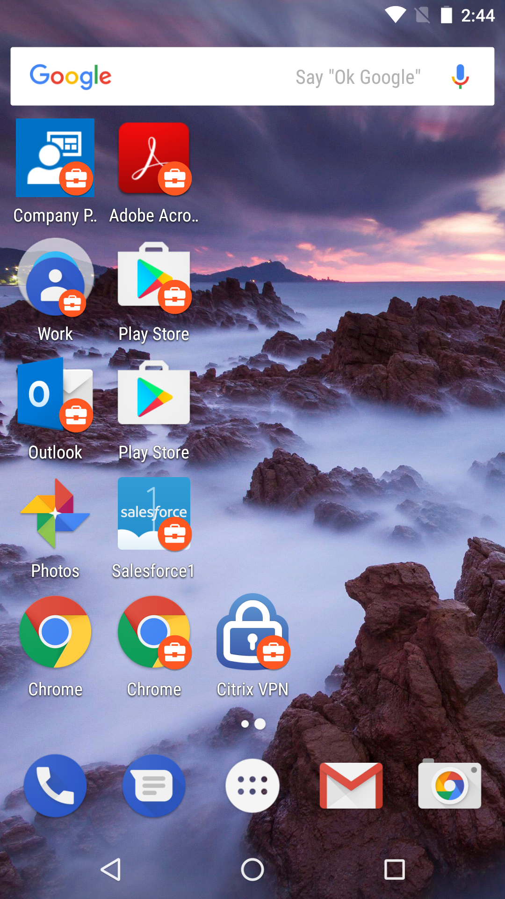
Moving from legacy to work profiles
Management
All legacy configurations supported on work profiles
Management scoped to work profile
Personal profile invisible to IT
No Google account required in work profile
Apps
Big changes, but big usability improvements!
In-house (LOB) apps must be published to Play
Play app is IW app catalog
Does not require unknown sources
Managed app configuration for supporting apps
Resource access
Handled through email app managed app config
VPN connections scoped to work profile

Slide 13
Demo Work Profiles

Slide 14
Enterprise Admin

Slide 15
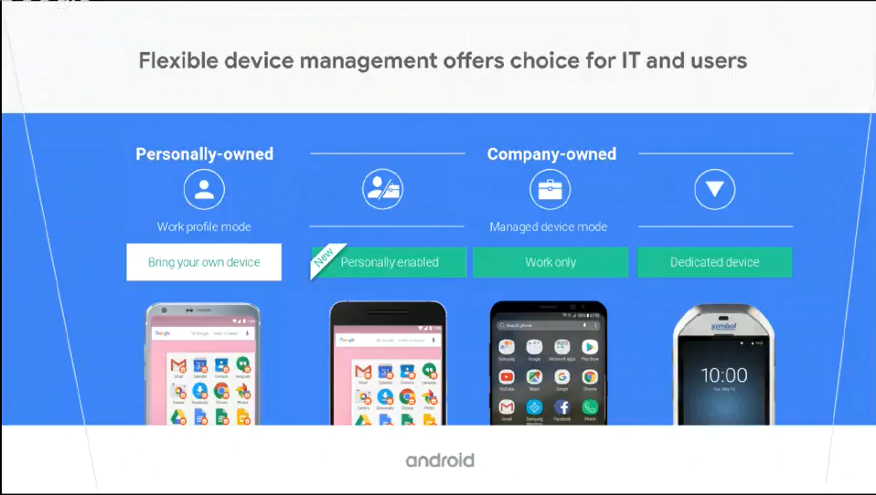
Native Android management options
https://www.android.com/enterprise/management/

Slide 16
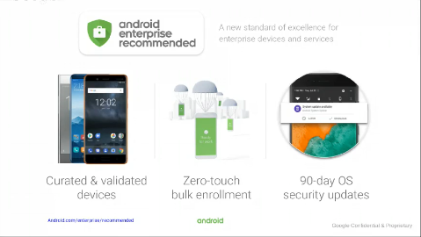
Android Enterprise drives consistency
Designed for Enterprise MGMT
Android Enterprise Recommended devices
Expanding management standards to the greater ecosystem
Rugged, knowledge worker device categories
https://www.android.com/enterprise/recommended/

Slide 17
Android Enterprise scenario in Intune
Today
Next
Unmanaged
APP-only
Device Owner
COSU/Kiosk
User-less kiosk scenarios
Device Owner
Personally enabled (COPE)
Apps & web links
Kiosk for any Android 6+ with GMS
Fully managed devices with user affinity
Like COBO, but with work profile
Separate levels of policy on work profile
Device Owner
Work managed (COBO)
Fully managed with user affinity
Restricted to work-only
No work vs. separation
Work profile
Self-enrollment
BYOD scenarios
Separation between work and personal
For all Intune-supported Android versions
KNOX mobile enrollment
Legacy enrollment (device administrator)
Corp-owned
User-centric
Android 4.4+

Slide 18
Enrollment options
With Device Admin
Google play store,
Sideload the app
Barcode
Android Enterprise
DPC Identifier
NFC for bulk enrollments
QR code
Zero Touch

Slide 19
Demo Kiosk

Slide 20
Demo Fully Managed

Slide 21
Scenarios

Slide 22
Outlook because security matters
Block any app but Outlook
Modern Auth
Disable native mail apps
Disable legacy mail apps
Work profiles
Prevent personal accounts in corporate container

Slide 23
Demo Outlook

Slide 24

Slides and demos from the conference will be available at
https://github.com/nordicinfrastructureconference/2019

